Slide 1
Meeting 23.07.

Slide 2
Architecture
Unet Architecture
Data preprocessing
Ecoder1 Conv
Decoder2 Conv
Trajectory
Convolutional encoding
Ecoder2 Conv
Decoder1 Conv
Flow Time
Sinusoidal Time embedding
Target
Shape
Average of target points
Bottleneck
MLP-Layer

Slide 3
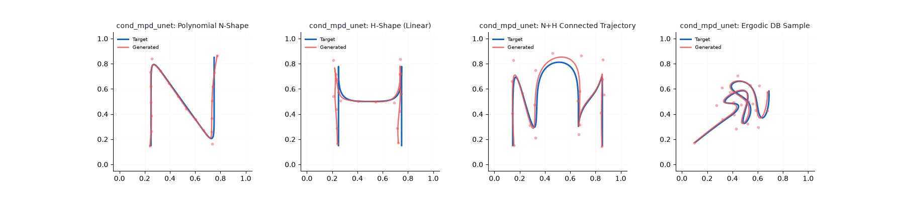
Result images

Slide 4
Findings this week
Data representation on the input
I used list of waypoints
Motion Planning Diffusion used list of states and actions
Looked into Unet architecture
Tested Architecture

Slide 5
Next week
Try training on dataset instead of overfitting
Add further conditioning/embeddings for other contraints
Try attention layers? – can be worth to try

